Slide 1
DR.SNSRCAS, CBE
SUBJECT: CLOUD TECHNOLOGY FUNDAMENTALS
COURSE CODE:21UCA501
TITLE: Salesforce.com and CRM SaaS
YEAR: III SEMESTER 2022-2023 (ODD)

Slide 2
Software as a Service (SaaS) is the Customer Relationship Management software offered by Salesforce.com whose solution offers sales, service, support, marketing, content, analytical analysis.
platform called Chatter.
Salesforce.com was founded in 1999 by a group of Oracle executives.
early adopters of many of the technologies that are becoming cloud computing staples.

Slide 3
Salesforce.com extended its SaaS offering to allow developers to create add-on applications.
Essentially turning the SaaS service into a Platform as a Service (PaaS) offering called the Force.com
Applications built on Force.com are in the form of the Java variant called Apex using an
XML.

Slide 4
syntax for creating user interfaces in HTML, Ajax, and Flex.
Essentially turning the SaaS service into a Platform as a Service (PaaS) offering called the Force.com
Nearly a thousand applications now exist for this platform from hundreds of vendors.

Slide 5
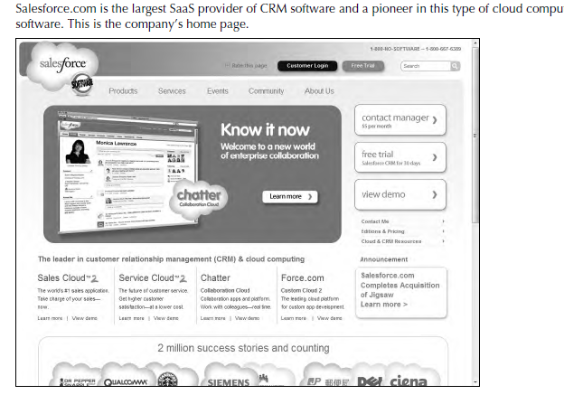

Slide 6
Defining Identity as a Service (IDaaS)
The establishment and proof of an identity is a central network function.
An identity service is one that stores the information associated with a digital entity in a form that can be queried and managed for use in electronic transactions.
Identity services have as their core functions: a data store, a query engine, and a policy engine that maintains data integrity.

Slide 7
Defining Identity as a Service (IDaaS)
Distributed transaction systems such as internetworks or cloud computing systems magnify the difficulties faced by identity management systems
exposing a much larger attack surface
Whether it is network traffic protection, privileged resource access, or some other defined right or privilege, the validated authorization of an object based on its identity is the central tenet of secure network design.

Slide 8
Defining Identity as a Service (IDaaS)
In this regard, establishing identity may be seen as the key to obtaining trust and to anything that an object or entity wants to claim ownership of.
. Services that provide digital identity management as a service have been part of internetworked systems from Day One.
The Domain Name Service can run on a private network

Slide 9
Defining Identity as a Service (IDaaS)
The name servers that run the various Internet domains (.COM, .ORG, .EDU, .MIL, .TV, .RU, and so on) are IDaaS servers.
. Services that provide digital identity management as a service have been part of internetworked systems from Day One.
The Domain Name Service can run on a private network

Slide 10
Thank You

